Slide 1
Term Project #1
Recommender System

Slide 2
Overview for Term Project
Number of Members : 4-5
Organizing Teams : ~11/18
Plan with data model : 11/30
Deadline & Presentation : 12/14

Slide 3
Requirements for Recommendations
Collect Data for Recommender System
Naver Movie or News, Movielens, DBLP
Describe a Data Model
Relationship between Data
Describe a Learning Model
CF
Word Embedding
Measurement
Precision/Recall
ROC Curve
(Optional) Visualization
Using GitHub for Project Management

Slide 4
Samples

Slide 5
Collaborative Filtering with KNN

Slide 6
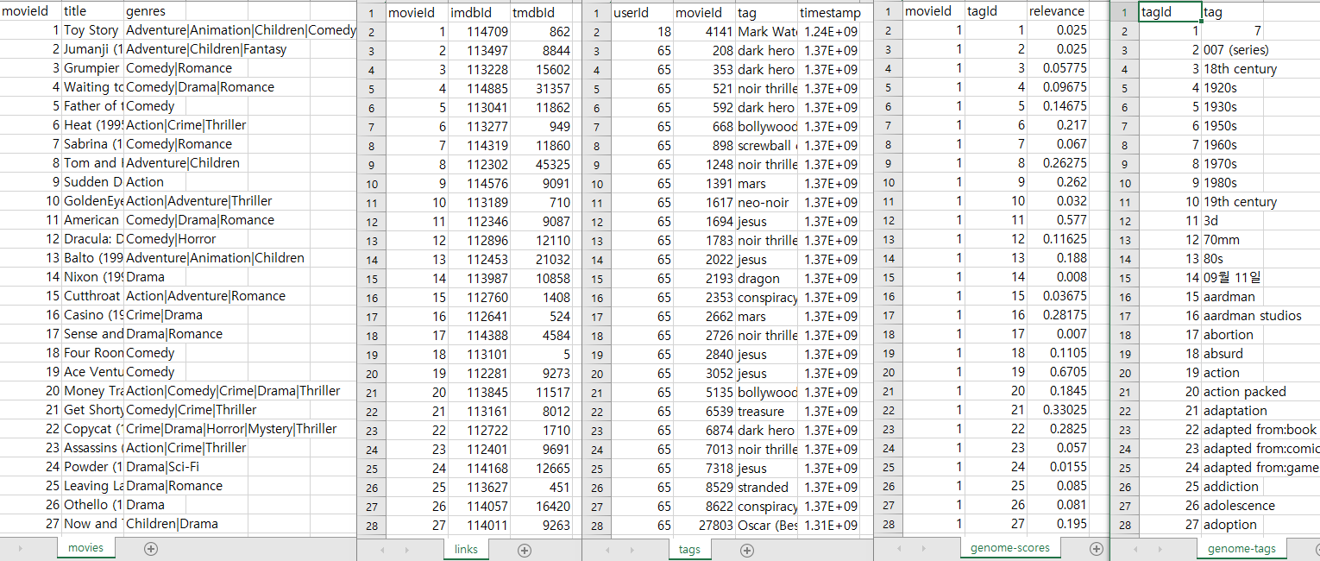
1. Data
Below is the dataset to be entered(https://grouplens.org/datasets/movielens/)
It contains 20000263 ratings and 465564 tag applications across 27278 movies.
Movie score range: 5-star rating
Each user is represented by an id.
All selected users had rated at least 20 movies.
<data example>

Slide 7
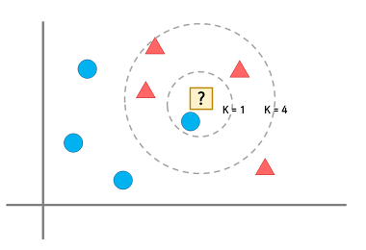
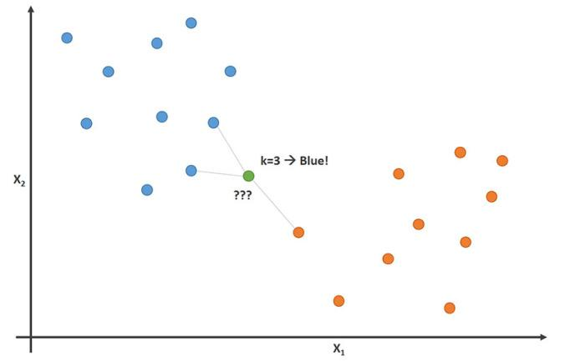
2. Model
KNN(K Nearest Neighbor) - utilization
When new data is entered, it is processed by judging what is closet to it.
Motive - Because it is simple and efficient, it is already widely used, so it is used to understand the recommendation system more directly.
Process - It is algorithm to classify the data and classify this new data by preempting the K nearest pointers and categorizing the most selected point when determining the category of the new data.
<simple KNN model>

Slide 8
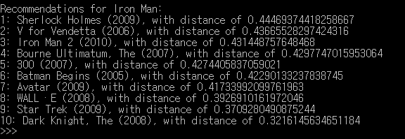
3. Result
For movie recommendation, the below result shows the probability of matching with the distance value as the probability when entering “Iron Man” as input value.
The below results recommend the 10 movies with the largest distance.
This means that the higher the distance value, the higher the matching probability.
<KNN recommendation result>

Slide 9
Collaborative Filtering with
Fuzzy Clustering

Slide 10

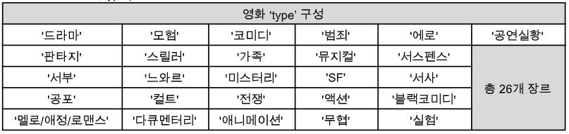
1. Data
Data
ratings : about 6,000,000
Size : 1.3GB
Type : movie_name, date, review_date, type, director, actor, nickname, text, rate
<Type_data>
<Nickname_data>

Slide 11
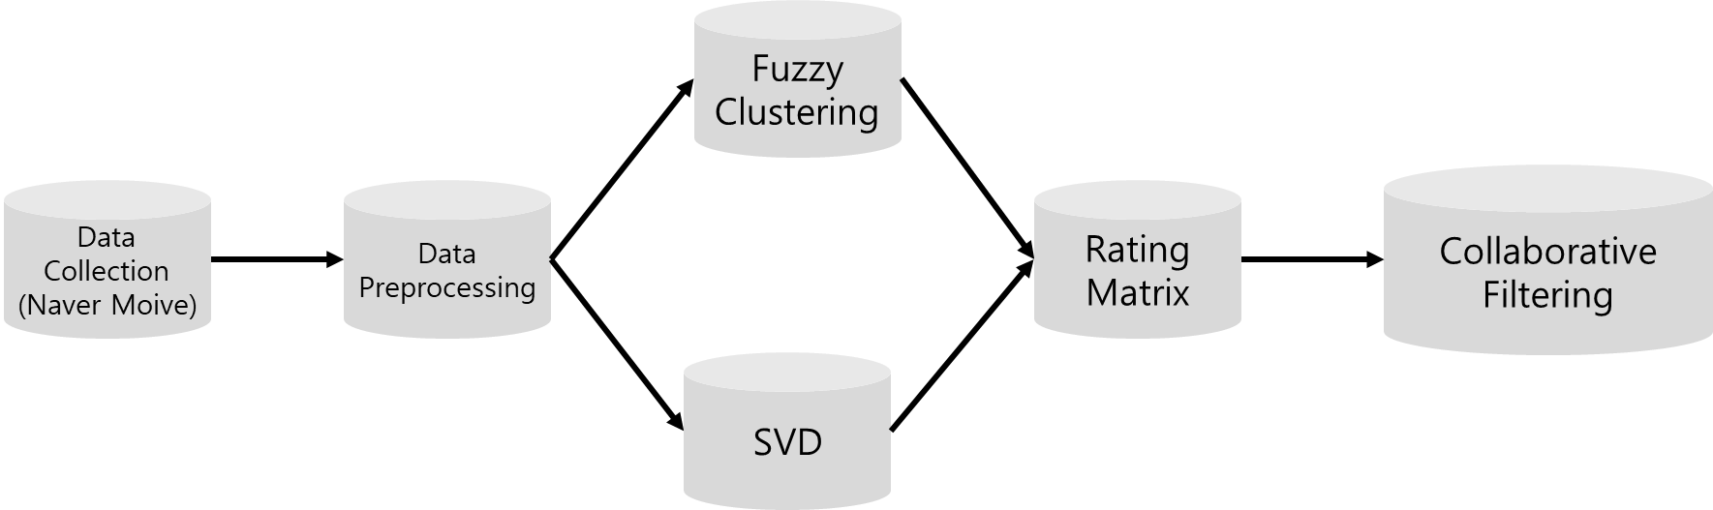
2. Model
<Fuzzy Clustering Model>
Problem
Users don't know what they like
Users themselves cannot accurately define that they like as much as 0.7 or 0.6 -> This is why the star rating is biased to 1 or 10.
Users like A a lot, B a little, and C a dislike. (Not classified as like or dislike)
Motivation
By applying fuzzy logic, you can configure clustering that reflects the user's taste more than k-means clustering and hierarchical clustering.
You can discover tastes you don't even know.
Available data has increased due to the explosive increase in data. However, only user-star information is used. Currently, various information such as user-movie genre, user-director, user-actor, etc. are not being utilized.

Slide 12
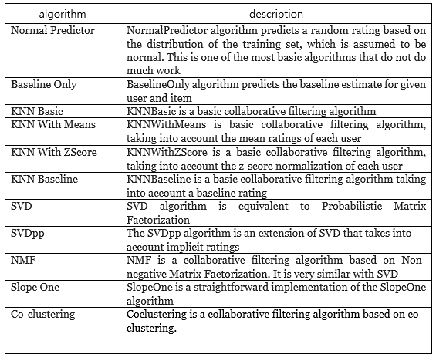
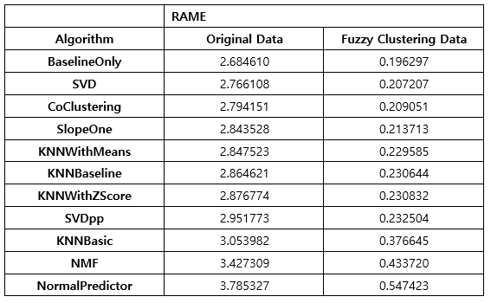
3. Result
<Evaluation algorithm>
<Accuracy of the proposed model>

Slide 13
Word embedding with word2vec

Slide 14
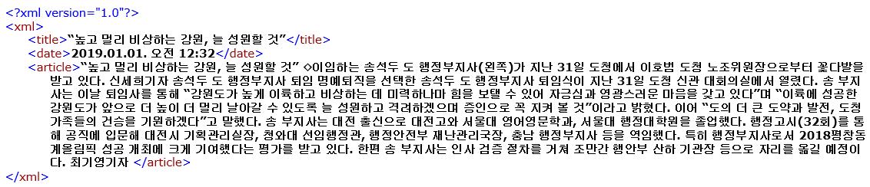
1. Data
Data
Number of document : about 587,425
Size : 6.4GB
Type : naver news text
Period: 2018.01.01 ~ 2019.12.31
Collection method: python Selenium pakage
<text example>

Slide 15
2. Model
x
1
y
1
x
2
y
2
x
3
h
y
3
input
[1,0,0,0]
h
1
output
[0,1,0,0]
x
2
k
h
y
i
j
W
W
V
×
N
h
'
N
×
V
N
x
V
y
V
<simple CBOW model>
Problem
If a word is expressed numerically through a method such as one-hot encoding, it is expressed as a sparse matrix.
Unable to learn the positional expression of words and thus cannot express similarities
Motivation
Words can be expressed in a fixed vector space and meaning similarities between words can be checked.
The model expresses words as dense vectors rather than words expressed as sparse vectors.

Slide 16
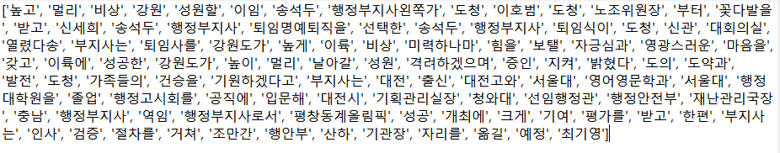
3. Result
Preprocessing – tokenize, stopwords, nouns, different on your way..
Word2vec model result
Similar words observed
Depending on the disaster, the 2nd and 3rd disaster words are observed
Observe accompanying disaster and damage words
Query | Similarity
침수 | 저지대(0.63), 농지도로(0.61), 범람(0.58),…
미세먼지 | 초미세먼지(0.75), 황사(0.64), 황사마스크(0.65),…
폭염 | 더위(0.64), 불볕더위(0.59), 폭염특보(0.53), 고온(0.51), 온열질환(0.50), 온열(0.49),…
한파 | 추위(0.62), 폭설(0.57), 대설(0.57), 강추위(0.51), 혹한(0.49), 겨울(0.49),…
지진 | 지진발생(0.60), 여진(0.56), 강진(0.55), 포항(0.48), 지진해일(0.46), 쓰나미(0.45),…
<similarity result>

